Slide 1
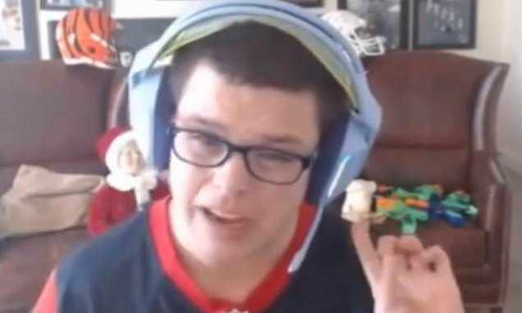
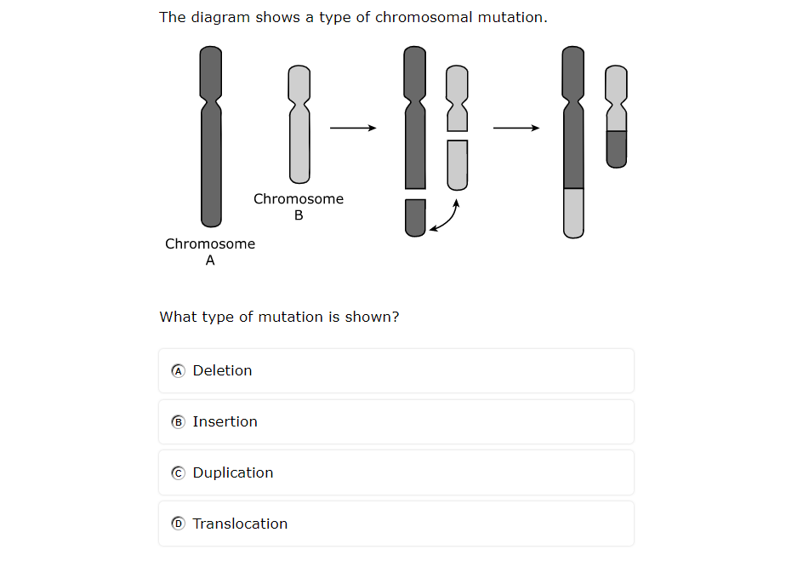
Toss a Question
Round 1: Analyze the stimulus and explain why it is important | Round 2: Identify and describe 3-5 key terms | Round 3: Predict the big idea
Round 4: Justify the best answer | Round 5: Justify the worst answer | Round 6: Predict a careless mistake & how to avoid it

Slide 2
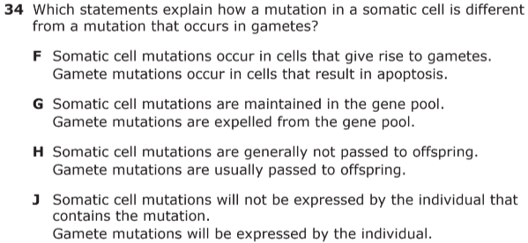
Toss a Question
Round 1: Analyze the stimulus and explain why it is important | Round 2: Identify and describe 3-5 key terms | Round 3: Predict the big idea
Round 4: Justify the best answer | Round 5: Justify the worst answer | Round 6: Predict a careless mistake & how to avoid it

Slide 3
Toss a Question
Round 1: Analyze the stimulus and explain why it is important | Round 2: Identify and describe 3-5 key terms | Round 3: Predict the big idea
Round 4: Justify the best answer | Round 5: Justify the worst answer | Round 6: Predict a careless mistake & how to avoid it

Slide 4
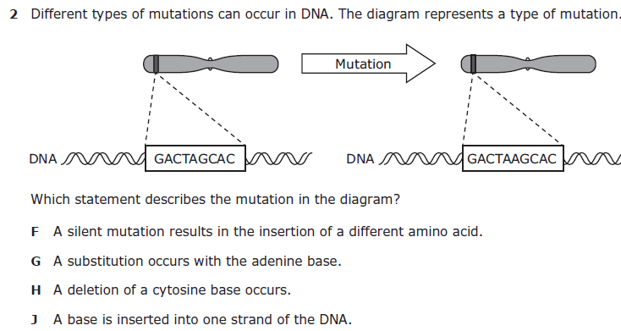
Toss a Question
Round 1: Analyze the stimulus and explain why it is important | Round 2: Identify and describe 3-5 key terms | Round 3: Predict the big idea
Round 4: Justify the best answer | Round 5: Justify the worst answer | Round 6: Predict a careless mistake & how to avoid it

Slide 5
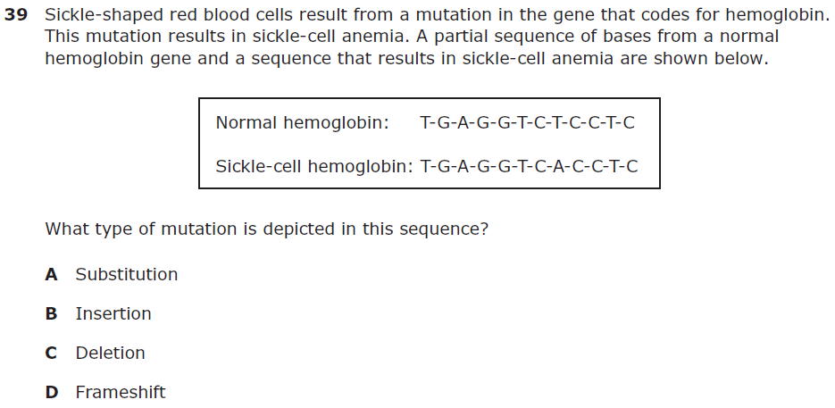
Toss a Question
Round 1: Analyze the stimulus and explain why it is important | Round 2: Identify and describe 3-5 key terms | Round 3: Predict the big idea
Round 4: Justify the best answer | Round 5: Justify the worst answer | Round 6: Predict a careless mistake & how to avoid it

Slide 6
Toss a Question
Round 1: Analyze the stimulus and explain why it is important | Round 2: Identify and describe 3-5 key terms | Round 3: Predict the big idea
Round 4: Justify the best answer | Round 5: Justify the worst answer | Round 6: Predict a careless mistake & how to avoid it

Slide 7
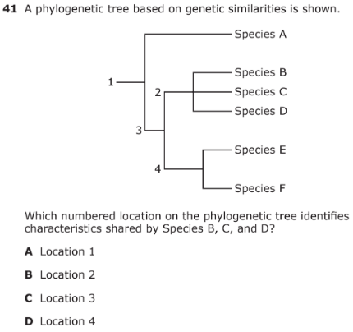
assessment question
analyze visual | If this visual could talk, it would tell us … This visual is important because … A tricky part of this visual is …
justify correct response and summarize 1 learning mistake to avoid | The correct answer is … because … One learning mistake to avoid on a question like this is …

Slide 8
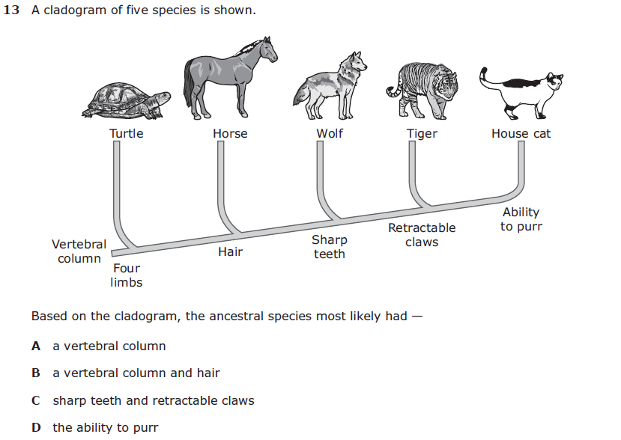
assessment question
analyze visual | If this visual could talk, it would tell us … This visual is important because … A tricky part of this visual is …
justify correct response and summarize 1 learning mistake to avoid | The correct answer is … because … One learning mistake to avoid on a question like this is …

Slide 9
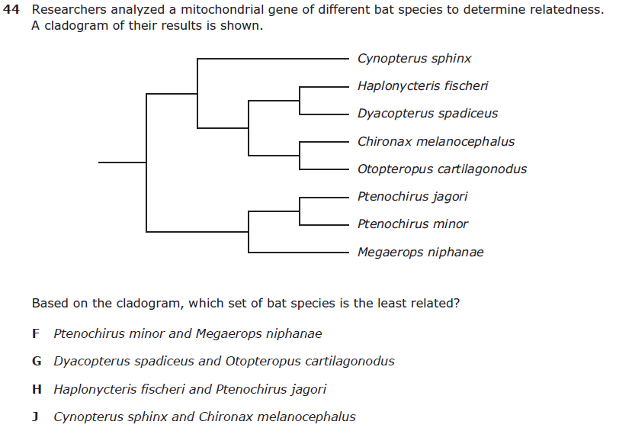
assessment question
analyze visual | If this visual could talk, it would tell us … This visual is important because … A tricky part of this visual is …
justify correct response and summarize 1 learning mistake to avoid | The correct answer is … because … One learning mistake to avoid on a question like this is …

Slide 10
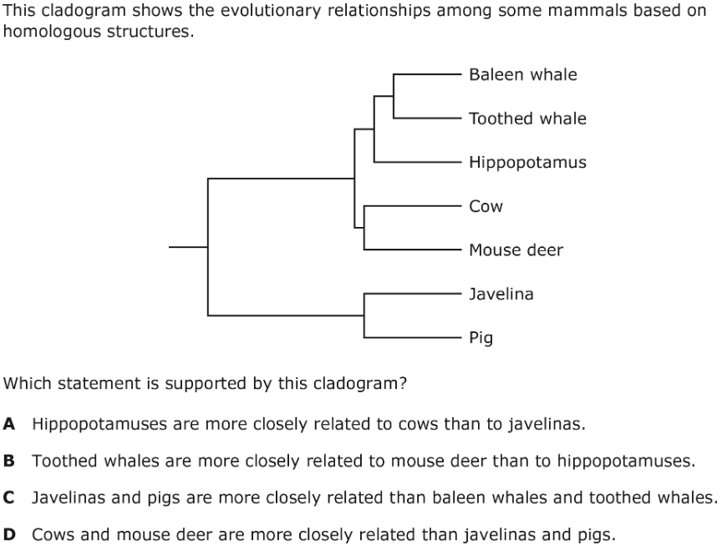
assessment question
analyze visual | If this visual could talk, it would tell us … This visual is important because … A tricky part of this visual is …
justify correct response and summarize 1 learning mistake to avoid | The correct answer is … because … One learning mistake to avoid on a question like this is …

Slide 11
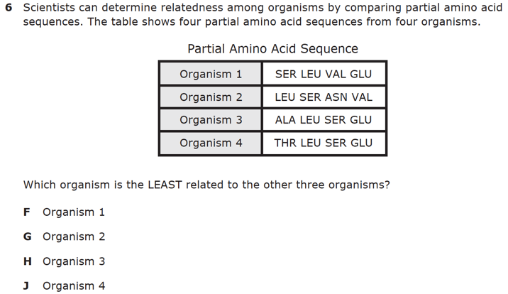
assessment question
analyze visual | If this visual could talk, it would tell us … This visual is important because … A tricky part of this visual is …
justify correct response and summarize 1 learning mistake to avoid | The correct answer is … because … One learning mistake to avoid on a question like this is …

Slide 12
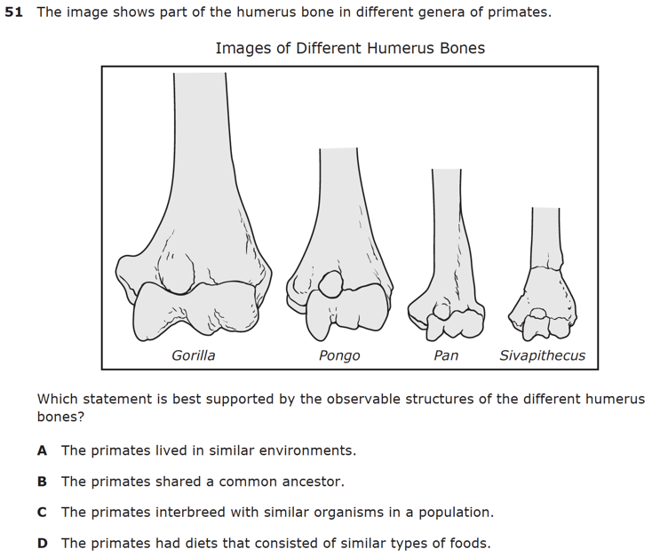
assessment question
analyze visual | If this visual could talk, it would tell us … This visual is important because … A tricky part of this visual is …
justify correct response and summarize 1 learning mistake to avoid | The correct answer is … because … One learning mistake to avoid on a question like this is …

Slide 13
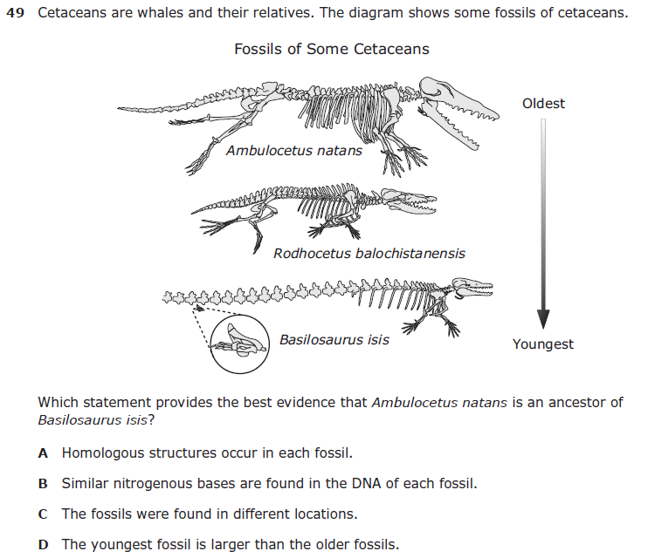
assessment question
analyze visual | If this visual could talk, it would tell us … This visual is important because … A tricky part of this visual is …
justify correct response and summarize 1 learning mistake to avoid | The correct answer is … because … One learning mistake to avoid on a question like this is …

Slide 14
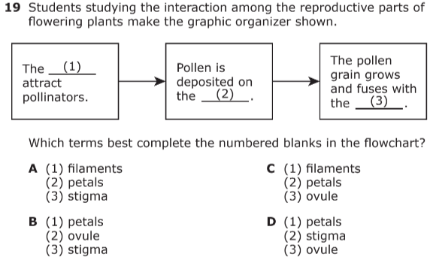
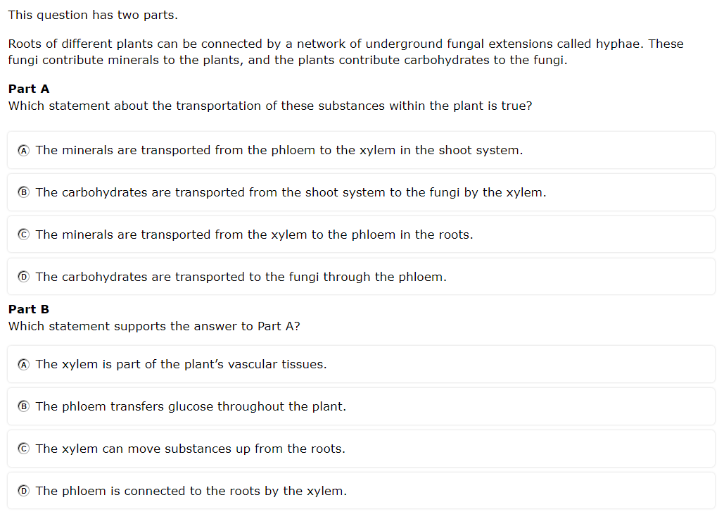
Question 1
Question 2

Slide 15
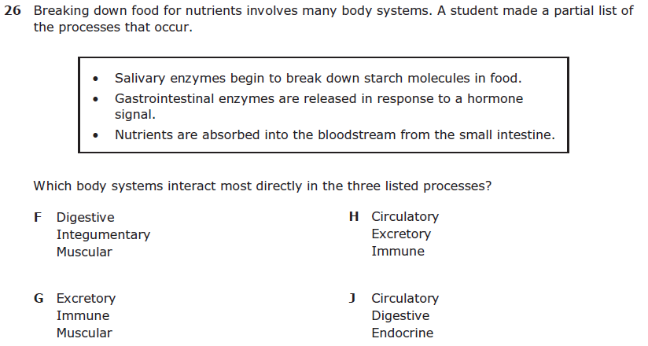
Question 3

Slide 16
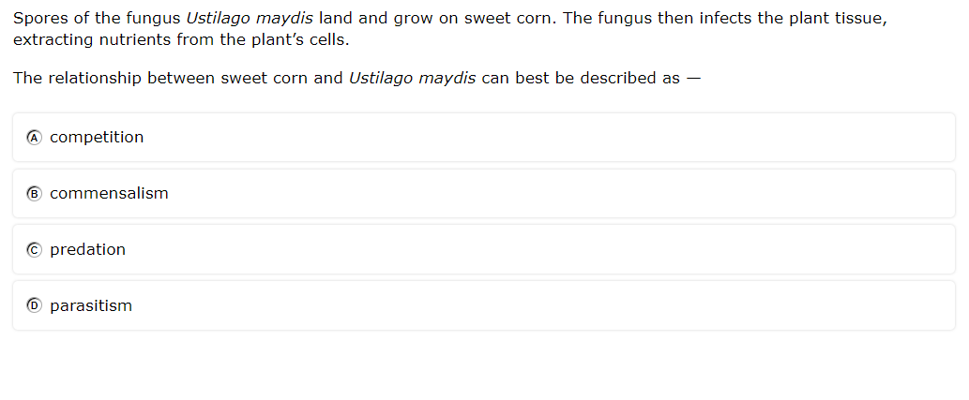
Each One Teach One
TOPIC
(What’s the
question about?)
VISUALS or STIMULI
(Is there a visual?)
START/FINISH
(How would you
start and finish?)
CORRECT ANSWER
(What’s the correct answer and WHY is it the best?)
INCORRECT ANSWERS
(Why are the other answers incorrect?)
Mix around the room to find a partner with a different colored question.
EACH ONE TEACHES ONE by coaching your partner on your original question.
Partners trade cards.
Find a new partner with a different color and coach each other on your new question.
Keep coaching/trading until you have learned and coached each color question.

Slide 17
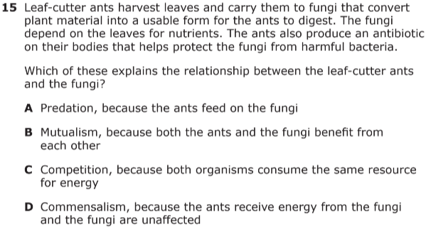
Each One Teach One
TOPIC
(What’s the
question about?)
VISUALS or STIMULI
(Is there a visual?)
START/FINISH
(How would you
start and finish?)
CORRECT ANSWER
(What’s the correct answer and WHY is it the best?)
INCORRECT ANSWERS
(Why are the other answers incorrect?)
Mix around the room to find a partner with a different colored question.
EACH ONE TEACHES ONE by coaching your partner on your original question.
Partners trade cards.
Find a new partner with a different color and coach each other on your new question.
Keep coaching/trading until you have learned and coached each color question.

Slide 18
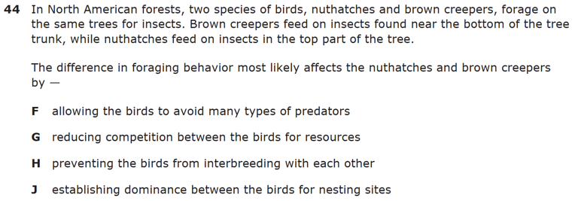
Each One Teach One
TOPIC
(What’s the
question about?)
VISUALS or STIMULI
(Is there a visual?)
START/FINISH
(How would you
start and finish?)
CORRECT ANSWER
(What’s the correct answer and WHY is it the best?)
INCORRECT ANSWERS
(Why are the other answers incorrect?)
Mix around the room to find a partner with a different colored question.
EACH ONE TEACHES ONE by coaching your partner on your original question.
Partners trade cards.
Find a new partner with a different color and coach each other on your new question.
Keep coaching/trading until you have learned and coached each color question.

Slide 19
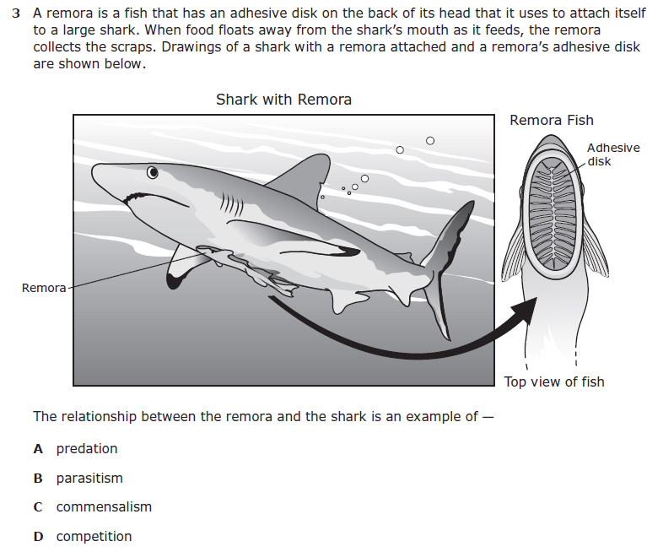
Each One Teach One
TOPIC
(What’s the
question about?)
VISUALS or STIMULI
(Is there a visual?)
START/FINISH
(How would you
start and finish?)
CORRECT ANSWER
(What’s the correct answer and WHY is it the best?)
INCORRECT ANSWERS
(Why are the other answers incorrect?)
Mix around the room to find a partner with a different colored question.
EACH ONE TEACHES ONE by coaching your partner on your original question.
Partners trade cards.
Find a new partner with a different color and coach each other on your new question.
Keep coaching/trading until you have learned and coached each color question.

Slide 20
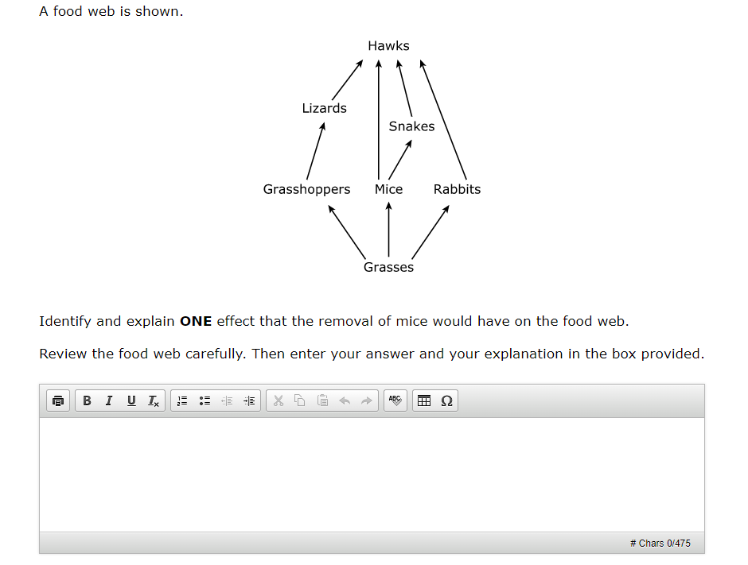
Toss a Question
Round 1: Analyze the stimulus and explain why it is important | Round 2: Identify and describe 3-5 key terms | Round 3: Predict the big idea
Round 4: Justify the best answer | Round 5: Justify the worst answer | Round 6: Predict a careless mistake & how to avoid it

Slide 21
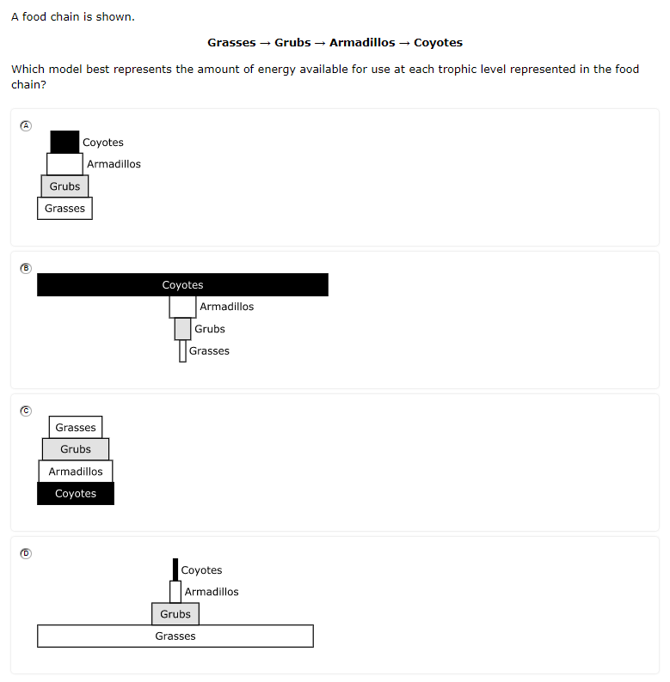
Toss a Question
Round 1: Analyze the stimulus and explain why it is important | Round 2: Identify and describe 3-5 key terms | Round 3: Predict the big idea
Round 4: Justify the best answer | Round 5: Justify the worst answer | Round 6: Predict a careless mistake & how to avoid it

Slide 22
Toss a Question
Round 1: Analyze the stimulus and explain why it is important | Round 2: Identify and describe 3-5 key terms | Round 3: Predict the big idea
Round 4: Justify the best answer | Round 5: Justify the worst answer | Round 6: Predict a careless mistake & how to avoid it

Slide 23
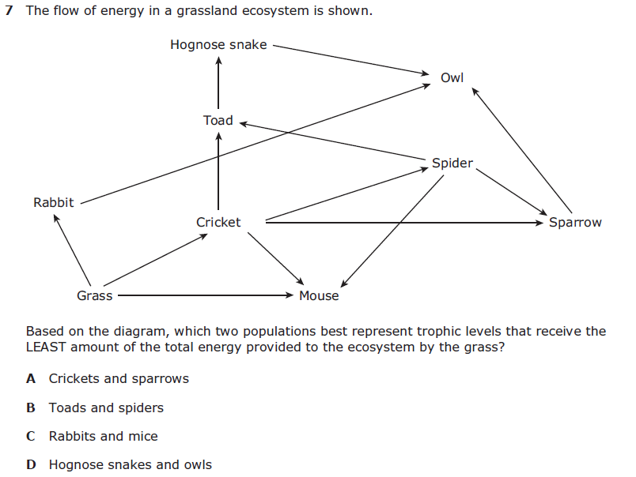
Toss a Question
Round 1: Analyze the stimulus and explain why it is important | Round 2: Identify and describe 3-5 key terms | Round 3: Predict the big idea
Round 4: Justify the best answer | Round 5: Justify the worst answer | Round 6: Predict a careless mistake & how to avoid it

Slide 24
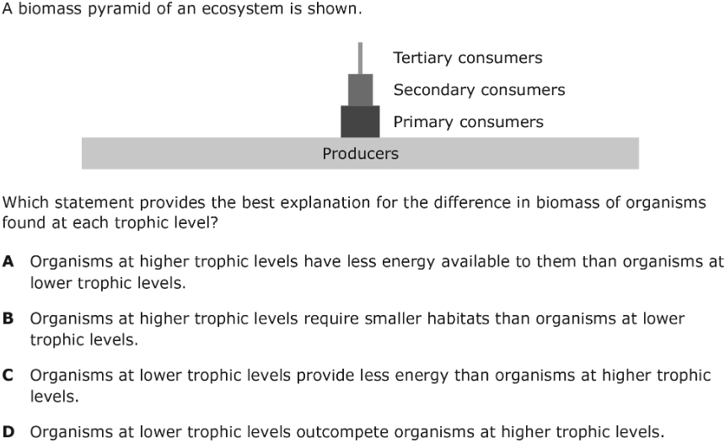
Toss a Question
Round 1: Analyze the stimulus and explain why it is important | Round 2: Identify and describe 3-5 key terms | Round 3: Predict the big idea
Round 4: Justify the best answer | Round 5: Justify the worst answer | Round 6: Predict a careless mistake & how to avoid it

Slide 25
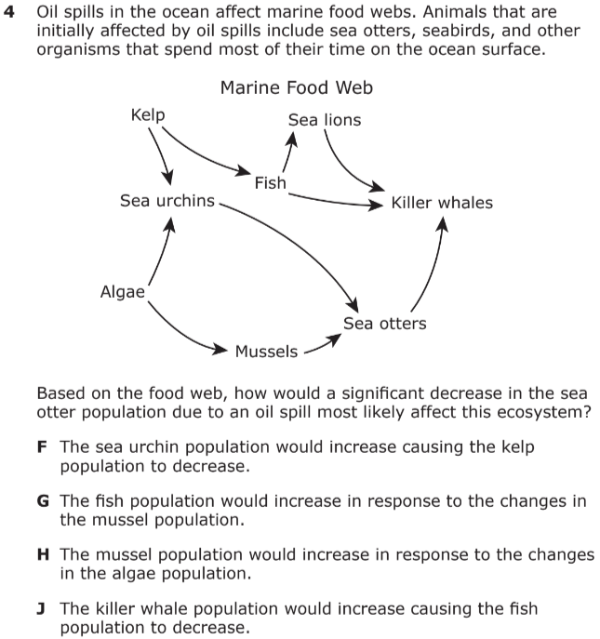

Slide 26
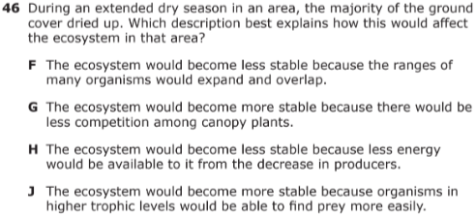

Slide 27
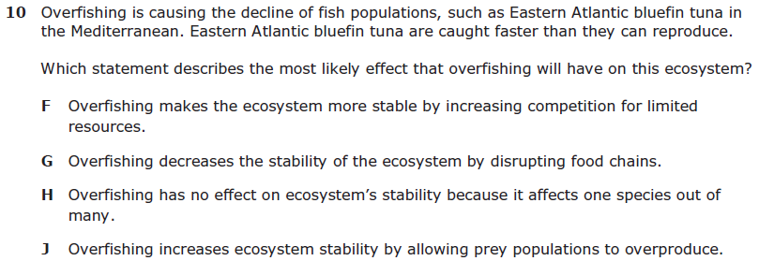

Slide 29
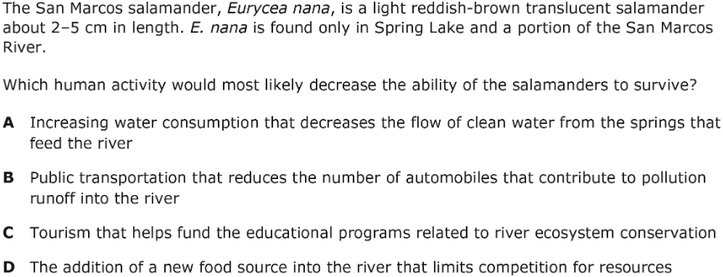

Slide 30
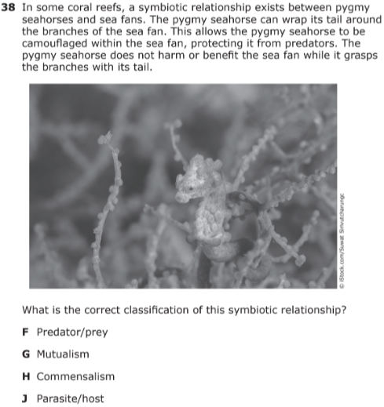

Slide 31
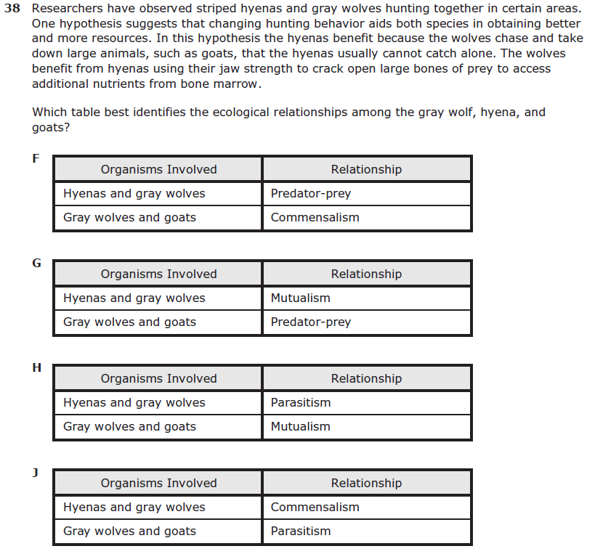

Slide 32
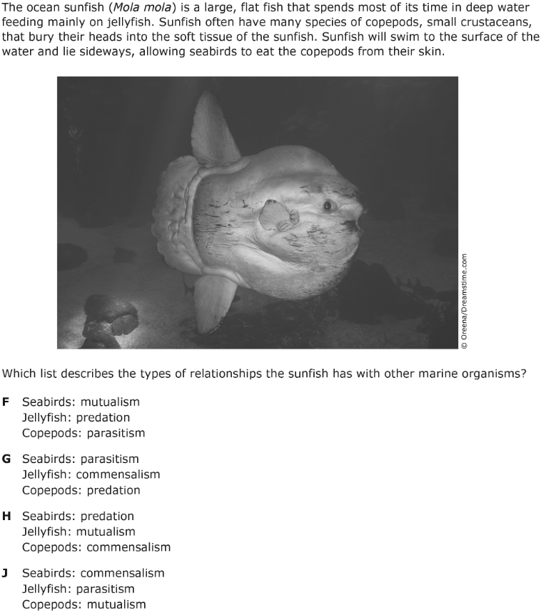

Slide 33
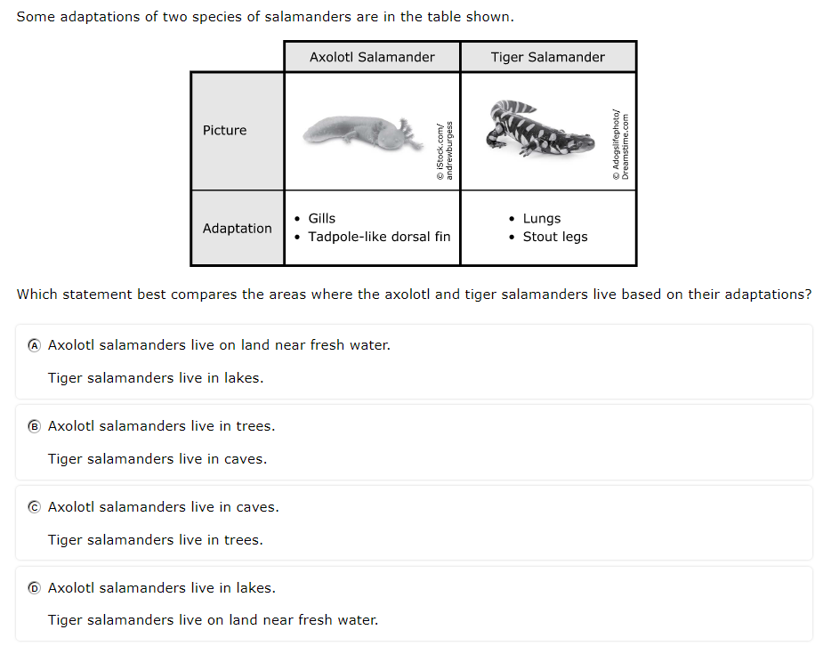

Slide 34
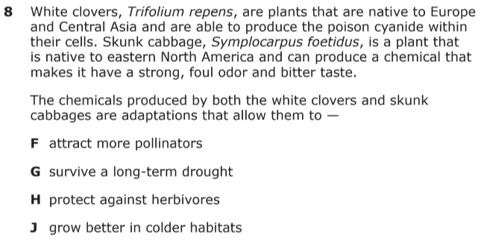

Slide 36
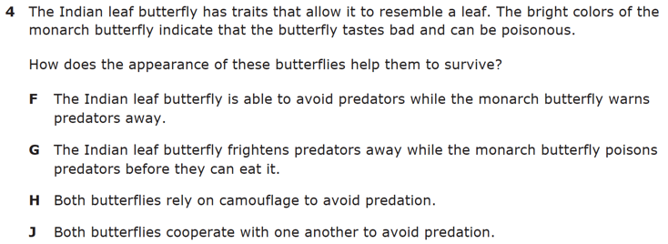

Slide 38
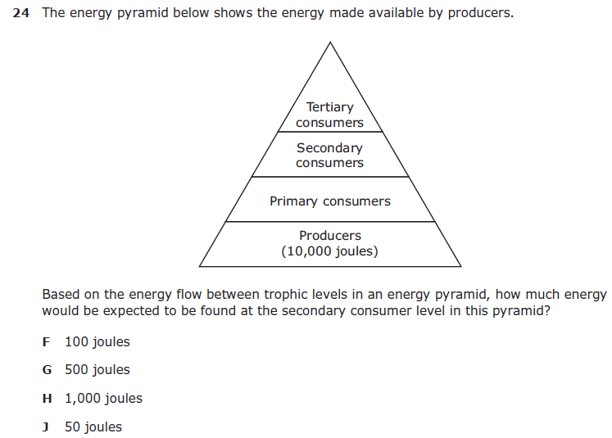

Slide 39
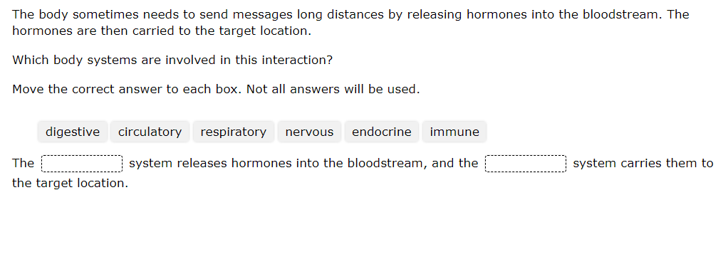
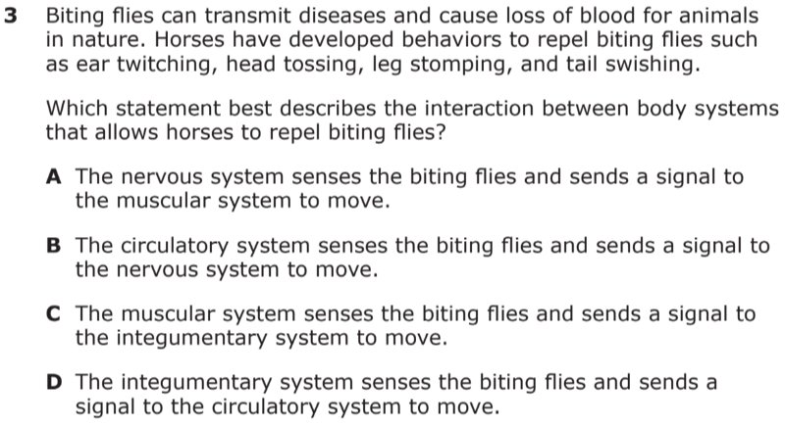
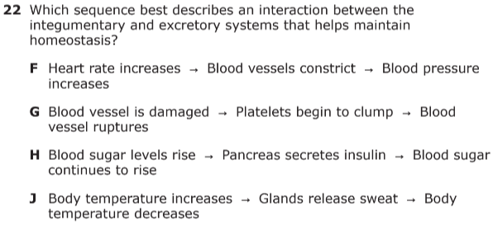
Crow

Slide 40
